Slide 1
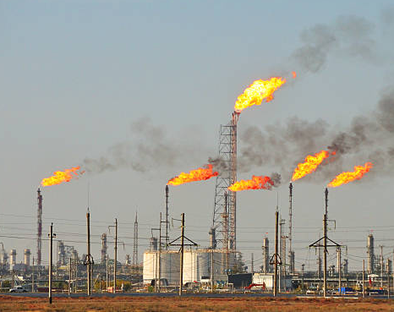
HPCL Project
Flare root cause identification
Results on July – October 2025 plant data

Slide 2
Goal: name the unit behind each flare and warn before it starts
Problem
Flares are frequent: 620 events of 30 min or more in four months, covering half of the time.
We want to see which unit moves first, and raise a warning before the flare starts.
What the method gives
A T² statistic per minute: one number for the whole plant.
Its causal split per PC: which unit's PC is out of line once its graph parents are accounted for.
Each PC traces back to its heaviest tags.
Data item | Value
Period | 1 Jul – 31 Oct 2025
Sampling | 1 minute (177,120 rows)
Units | 13 unit folders
Process tags used | 301 (75 of 376 dropped)
Flare signal | flare_net (t/h), from 4 flare tags
Flare event | flare_net > 1.5 t/h for ≥ 30 min
Flare events | 620 (88,590 min, 50 % of time)
Normal rows (NOC) | 35,978 (first 60 %, no flares)
Source: outputs/SUMMARY.md and logs/run.log. Dropped tags: 49 with negative values, 19 with > 10 % missing, 7 constant or near-constant.

Slide 3
Our approach in six steps, from raw tags to a ranked list of units
Top row: step; middle: what it does; bottom (dashed): result in this lab run.
1 DATA
2 UNIT-WISE PCA
3 PC ALGORITHM
4 DAG + FLARE
5 CAUSAL T²
6 DETECT + RANK
Join tags on a 1-min grid, drop bad tags, fill small gaps, standardise with NOC
One PCA per unit on NOC rows; keep PC1 and PC2 of each unit
Learn causal links among the PCs only (flare_net is not an input)
Orient to a graph without loops; add PC → flare_net for every PC
Moving 1,250-min baseline; overall T² and one T² term per PC
Flag a flare if T² is above the limit in the 60 min before it; rank PCs
301 tags
177,120 rows
24 PCs
46.7 % variance
75 edges
68 between units
0 loops
24 edges to flare_net
limit 74.7
per PC ≈ 7.7
F1 = 0.765
top 3 PCs per event
Changed since the last review
Warning window
60 min before onset (was 30)
Scoring
TP/FN per flare event, FP per gap, F1
T²
inv(R), no pseudo-inverse
Normal rows
no 120-min buffer around flares
Units
13: unit_wise_control_data not in this run

Slide 4
How we score: one count per flare event and one per gap between flares
minutes with T² above its limit
60 min
flare
60 min
flare
60 min
flare
Gap: T² rose twice
→ 1 FP
T² rose in the 60 min
→ TP
Gap: no rise
→ not counted
No rise in the 60 min
→ FN
One long rise: in the gap → 1 FP;
in the 60 min → TP
Flare block = [onset − 60 min, flare end]. Gap = time between two flare blocks.
TP: T² above its limit at least once in the 60 min before onset. FN: never above.
FP: a gap with T² above its limit at least once, however long or how often.
TN is not counted. No alarm delays: one minute above the limit is enough.
Minutes with no T² value are not scored.
F1 = 2 TP / (2 TP + FP + FN)
Rules: unit_pca_pc_t2/evaluation.py, evaluate(); window FLARE_PRE_WINDOW_MIN = 60 (config.py). Only flare events ≥ 30 min count as flares.

Slide 5
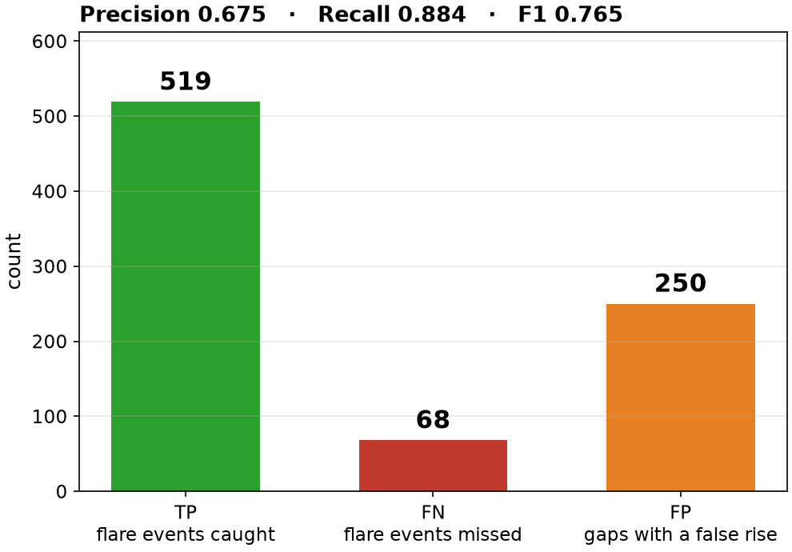
F1 = 0.77: T² rose before 519 of 587 flares, but also in 250 of 266 gaps
=====================================
FLARE DETECTION, JUL – OCT 2025
=====================================
Flare events (>= 30 min) : 620
not scored (no T²) : 33
scored : 587
TP events caught : 519
FN events missed : 68
-------------------------------------
Gaps between flare blocks : 270
not scored : 4
FP gaps with T² rise : 250
-------------------------------------
Precision = TP/(TP+FP) : 0.675
Recall = TP/(TP+FN) : 0.884
F1 = 2TP/(2TP+FP+FN) : 0.765
Median warning (TP) : 45 min
=====================================
Source: outputs/tables/metrics.csv, event_outcomes.csv, nonflare_blocks.csv. Lab run of unit_pca_pc_t2 (commit 2f3c75a), 1-min data, 1 Jul – 31 Oct 2025.
Reading: recall is high (0.884): only 68 of 587 flares were missed. Precision is lower (0.675): 250 of the 266 scored gaps also had a T² rise, and these FPs pull F1 down to 0.765.

Slide 6
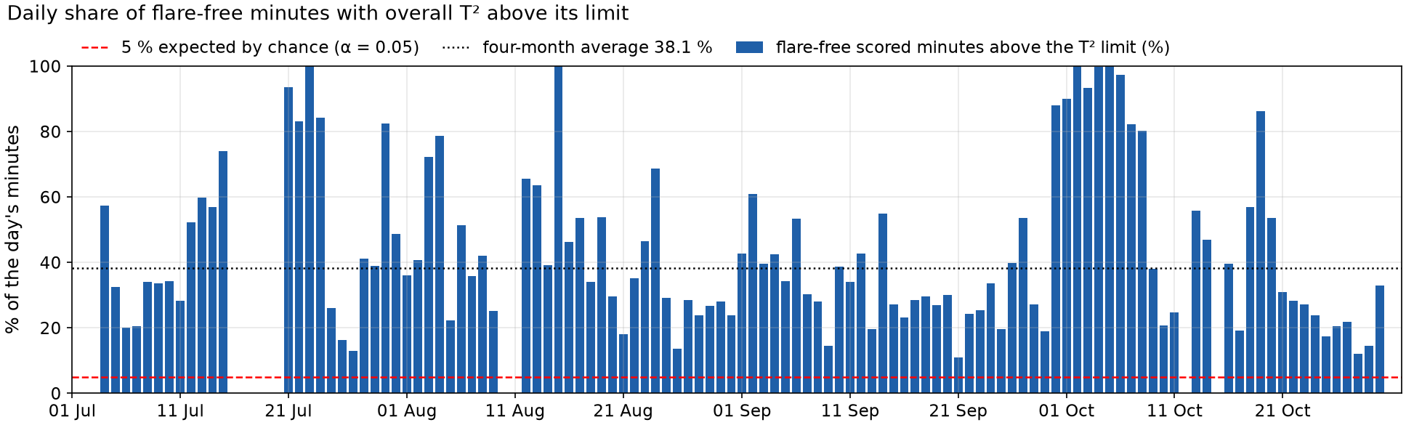
T² is high so often that an always-on alarm would score F1 = 0.82
Source: outputs/t2/t2_all_rows.parquet (overall T², above_limit, scored; flare-free = outside flare events and short flares). Lab run of unit_pca_pc_t2 (commit 2f3c75a), 1-min data, 1 Jul – 31 Oct 2025.
Overall T² is above its limit in 38 % of flare-free minutes (38 % of NOC minutes). By chance it should be about 5 % or less.
An alarm that is always on would catch every scored flare and flag every scored gap: F1 = 2·587 / (2·587 + 266) = 0.815, higher than our 0.765.
So the current F1 does not yet show skill: the T² limit is crossed too easily.

Slide 7
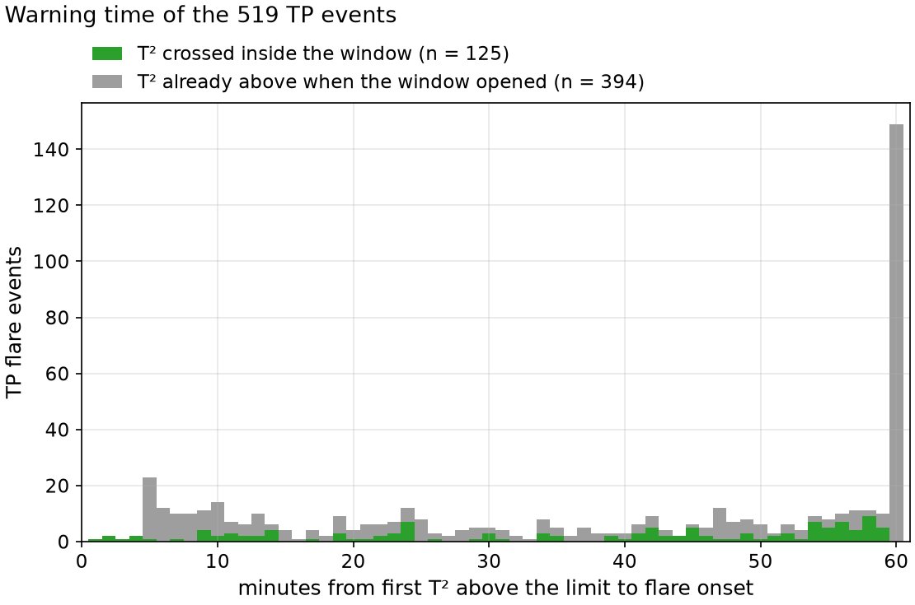
In 394 of 519 TP events T² was already high an hour before the flare
Green (125 events): T² was below the limit when the window opened and crossed inside it: a genuine rise before the flare. Median 42 min before onset.
Grey (394 events): T² was already above the limit when the window opened. These count as TP under the rule, but the rise did not start in the hour before the flare.
Grey bars sit at 60 min, or less when the window starts right after an earlier flare.
Source: outputs/tables/event_outcomes.csv (lead_min, above_at_window_start). Lab run of unit_pca_pc_t2 (commit 2f3c75a), 1-min data, 1 Jul – 31 Oct 2025.
Reading: only 125 of 519 TP events show T² rising inside the 60-min window; this is the stronger evidence of an early warning.

Slide 8
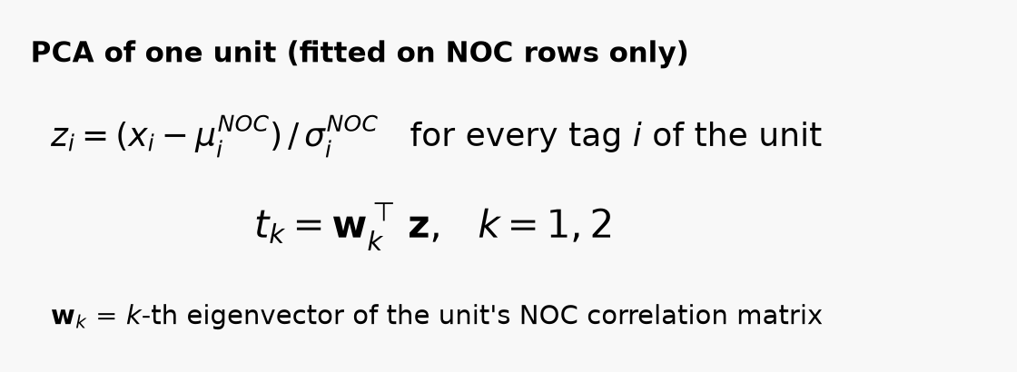
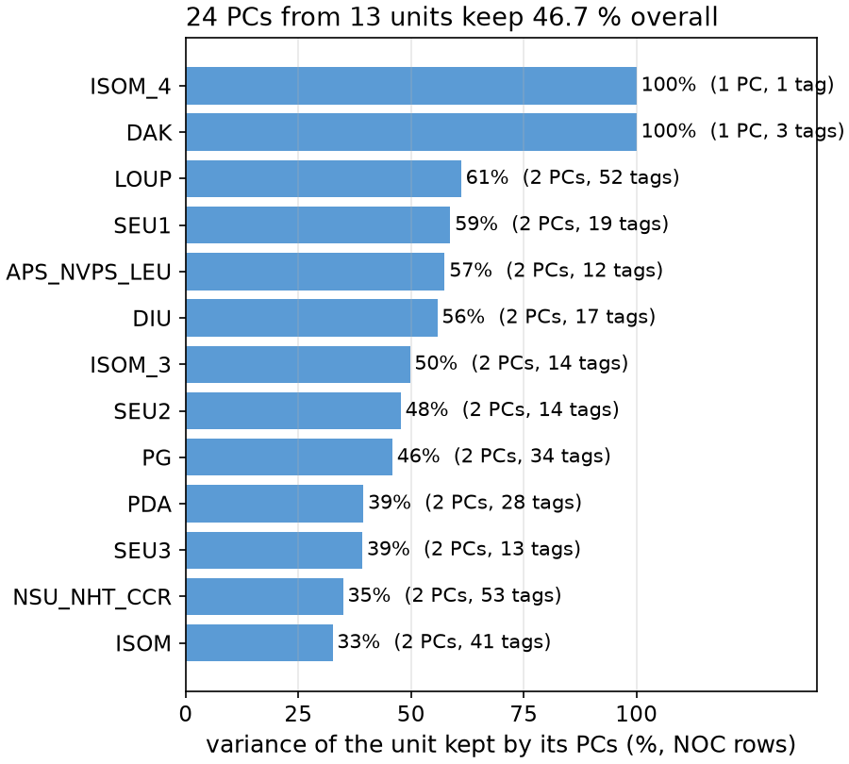
How PCs work: each unit's tags are compressed into two scores
Tags of one unit move together; PCA finds the directions in which they move most.
PC1 is the strongest common movement of the unit, PC2 the next, uncorrelated with PC1.
The weights w (loadings) tell which tags drive a PC, so a PC can be traced back to tags.
Example: SEU2_PC1 is driven mostly by PPC3215.PV (21 %) and PPI3205.PV (19 %).
Fitted on NOC rows only, then applied to every minute.
Why per unit: a PC then belongs to one unit, so a high T² term points to that unit.
Source: outputs/tables/pcs_per_unit.csv and pca_loadings.csv. DAK has rank 1 and ISOM_4 has one tag, so each gives 1 PC.

Slide 9
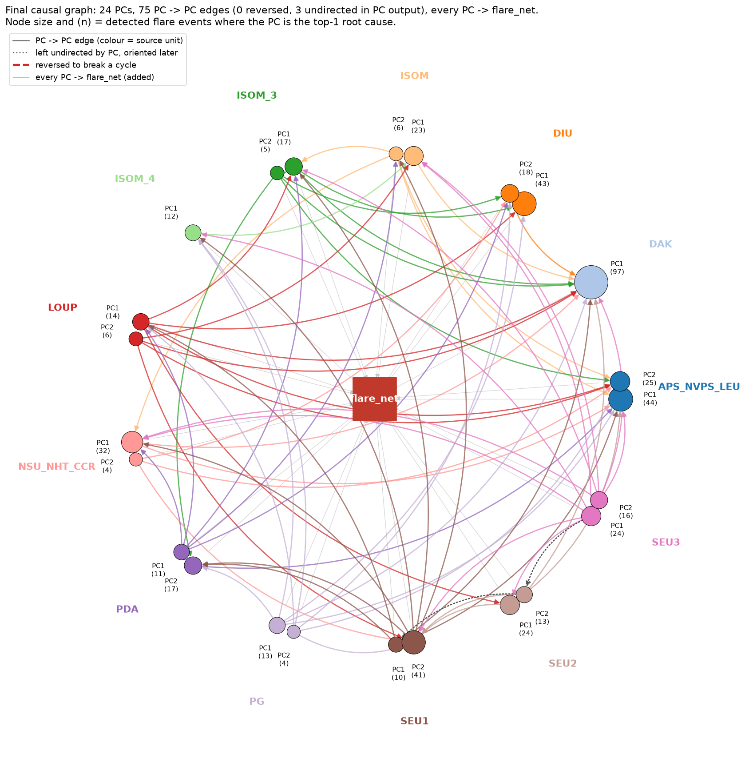
The PC algorithm links the 24 PCs with 75 edges, 68 between units
Input: the 24 PC scores, every 10th minute (17,712 rows). flare_net is not an input.
Test: Fisher-Z, α = 0.01, stable PC, conditioning sets up to 3 PCs.
Output: 75 edges (72 directed, 3 undirected); 68 link different units.
Parents per PC: mean 3.12, max 11 (DAK_PC1); 7 PCs have none.
Then every PC gets an edge to flare_net (24 edges, added by us, not learned).
This run's PC output has no loops (next two slides).
Figure: outputs/figures/fig5_causal_graph.png; edges: outputs/graph/pc_edges.csv and dag_edges.csv. Node colour = unit; (n) and node size = TP events where the PC is top-1.

Slide 10
Loops: the previous run had three, all through PDA → LOUP
# | Loop found by simple_cycles | Length
1 | SEU1_PC1 -> PDA_PC1 -> LOUP_PC1 -> SEU1_PC1 | 3
2 | SEU1_PC1 -> PDA_PC1 -> LOUP_PC1 -> CTRL_PC1 -> SEU1_PC1 | 4
3 | LOUP_PC1 -> CTRL_PC1 -> PDA_PC1 -> LOUP_PC1 | 3
SEU1
PC1
PDA
PC1
Why loops matter: each PC's T² term removes what its parents explain. In a loop a PC is its own ancestor, so no order puts every parent first and the T² split loses its meaning.
How we find them: list every directed cycle of the PC output with networkx.simple_cycles (check_cycles.py, same check as the TA's Main.py).
Previous run: 14 units, 26 PCs, 87 edges (85 directed); 3 loops, two of them through the control-data PC.
CTRL
PC1
LOUP
PC1
Directed edges among these four PCs in the previous run's PC output (commit eaebb1e). Red = PDA_PC1 → LOUP_PC1, on all three loops. CTRL_PC1 = unit_wise_control_data_PC1.

Slide 11
Loop removal reversed PDA → LOUP; the current run has no loops
Procedure (cpdag_to_dag): repeatedly take a PC with no outgoing edge and point its edges into it. When none is left, every remaining PC leads into a loop: remove the one with the fewest outgoing edges and reverse them.
Previous run: PDA_PC1 → LOUP_PC1 reversed, breaking all three loops. ISOM_3_PC2 → CTRL_PC1 was reversed too although it was not on a loop (tie-break by name order): a weakness of the rule.
SEU1
PC1
PDA
PC1
 | Previous run | Current run
Unit folders | 14 | 13
PCs / NOC rows | 26 / 12,157 | 24 / 35,978
Loops in PC output | 3 | 0
Edges reversed | 2 | 0
CTRL
PC1
LOUP
PC1
Same four PCs in the previous run's final graph (dag_edges.csv at eaebb1e). Red dashed = the reversed edge, now LOUP_PC1 → PDA_PC1. No loop is left.
Two inputs changed between the runs (control-data unit left out, NOC without the buffer), so we cannot say which one removed the loops. Sources: graph/{pc_edges, dag_edges, dag_stats, cycles}.csv in both commits.

Slide 12
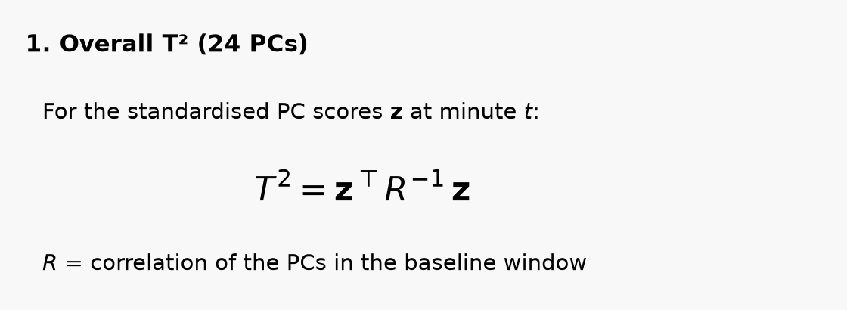
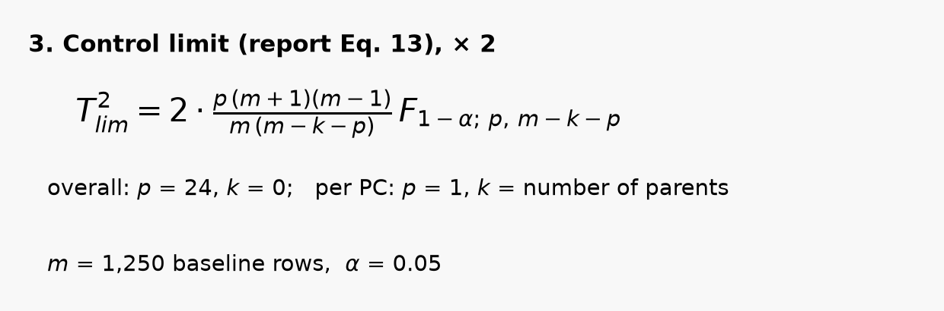
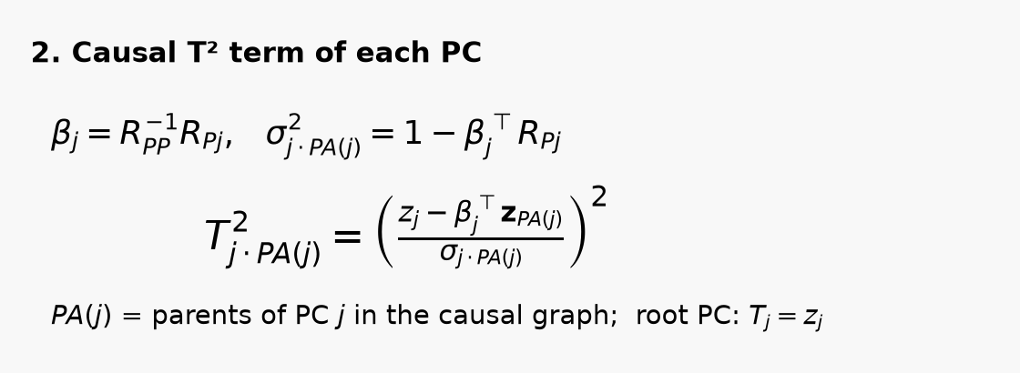
Each PC's T² term is measured after removing what its parents explain
Limits: overall 74.69, per PC 7.70 – 7.77, both × 2 (TA's notebook scales by 1.2 – 1.5).
Moving baseline: flare-free minutes in the last 1,250 min, re-estimated every 10 min.
Fewer than 100 such minutes: no T². That is 24,240 minutes, 94 % inside flares, incl. 1 – 4 Jul (first T² 04 Jul 04:30).
Root cause = PCs ranked by T²_j / own limit at the first minute above the overall limit.
Equations: unit_pca_pc_t2/MATHS.md (report Eqs. 7, 9–13); R⁻¹ is computed with numpy.linalg.inv. Values: outputs/t2/limits.csv and term_limits.csv.

Slide 13
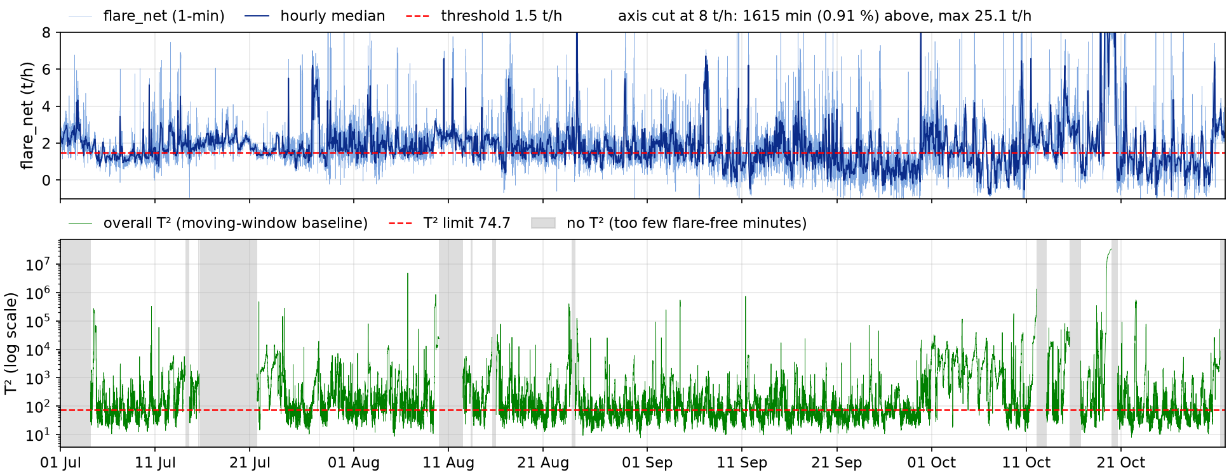
Over four months T² is above its limit in 38 % of flare-free minutes
Source: outputs/tables/flare_net_raw.parquet and t2/t2_all_rows.parquet. Lab run of unit_pca_pc_t2 (commit 2f3c75a), 1-min data, 1 Jul – 31 Oct 2025.
flare_net is cut at 8 t/h so the bulk (0 – 5 t/h) is visible; dark line = hourly median. T² is on a log scale.
T² stays near or above its limit 74.7 for most of the period, with or without a flare. The top 1 % of minutes exceed 161,471; the maximum is about 34 million.
Grey bands: no T² value (too few flare-free minutes in the baseline window).

Slide 14
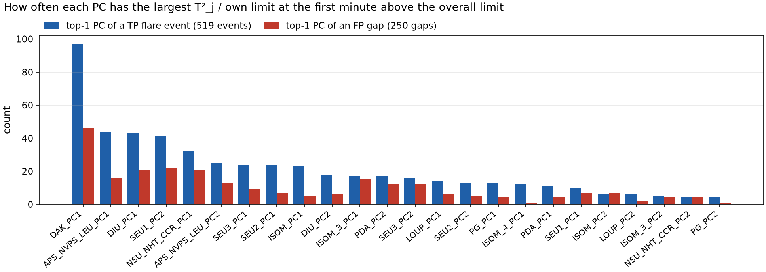
Which PCs rank first: DAK_PC1 leads 97 TP events and 46 FP gaps
Source: outputs/tables/event_outcomes.csv (pc1 of TP events) and nonflare_blocks.csv (pc1 of FP gaps). Lab run of unit_pca_pc_t2 (commit 2f3c75a), 1-min data, 1 Jul – 31 Oct 2025.
By unit (top-1 counts, TP / FP): DAK 97 / 46, APS_NVPS_LEU 69 / 29, DIU 61 / 27, SEU1 51 / 29.
The PCs that lead the TP events also lead the FP gaps: ranking first is not by itself a cause.
A median of 3 PCs are above their own limit at that minute, both in TP events and in FP gaps; in 45 TP events even the top PC is below its limit.

Slide 15
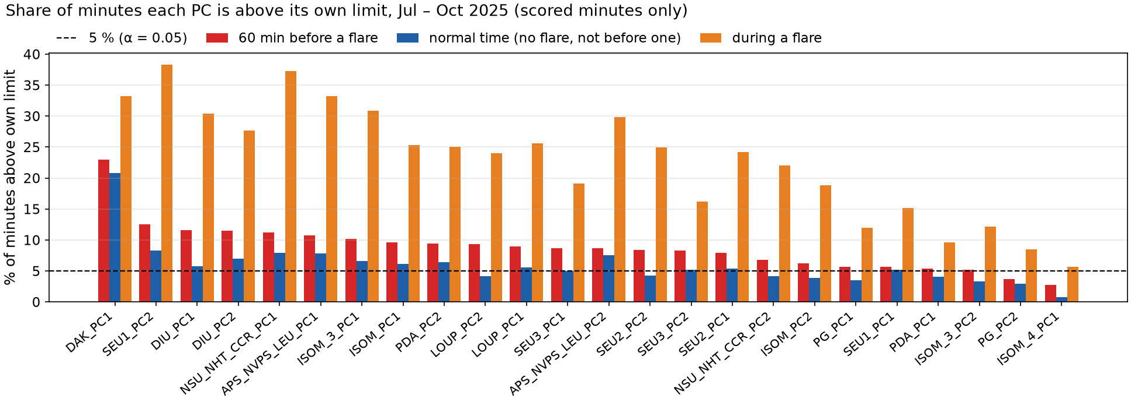
Every PC is above its limit more often before flares than in normal time
Source: outputs/t2/terms_all_rows.parquet and t2_all_rows.parquet (scored minutes: 23,293 before flares, 54,206 normal, 65,814 during flares). Lab run of unit_pca_pc_t2 (commit 2f3c75a), 1-min data, 1 Jul – 31 Oct 2025.
Before flares, LOUP_PC2 (2.2×), DIU_PC1 (2.0×), SEU2_PC2 (2.0×) are above their limit about twice as often as in normal time: the clearest pre-flare signal by PC.
DAK_PC1 is above its limit 23 % of the time before flares and 21 % in normal time: no difference, despite leading the ranking.
In normal time 15 of 24 PCs are still above their limit more than 5 % of the time; during flares almost all are far above.

Slide 16
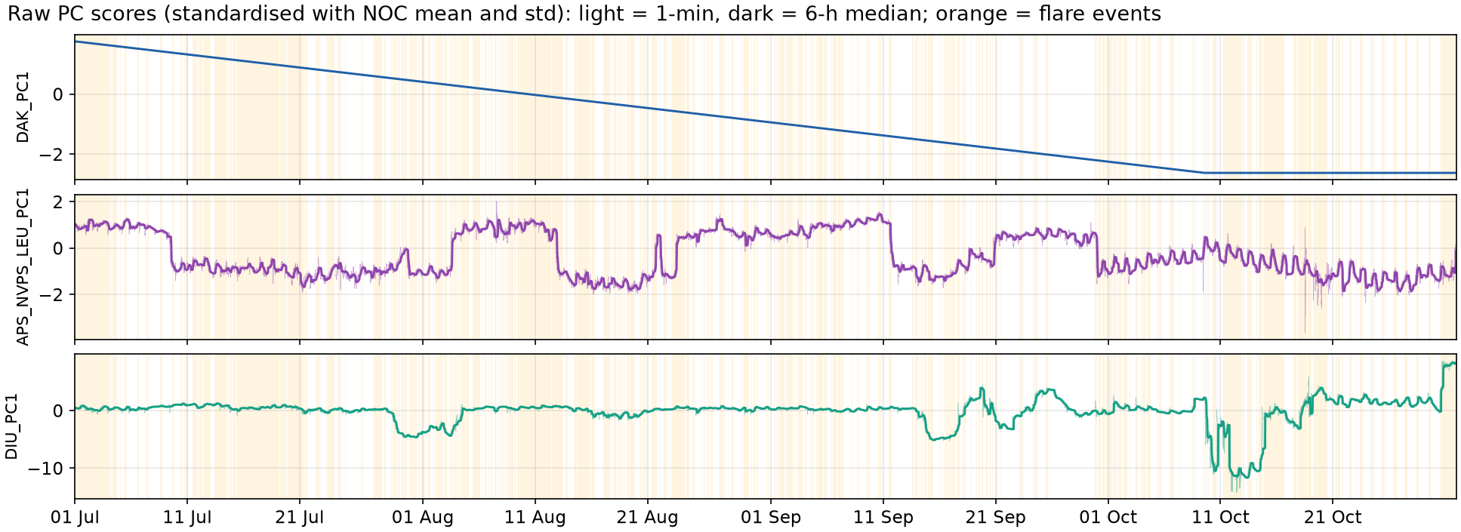
The three PCs ranked first most often, as raw scores over four months
Source: outputs/graph/pc_scores.parquet. Lab run of unit_pca_pc_t2 (commit 2f3c75a), 1-min data, 1 Jul – 31 Oct 2025.
DAK_PC1 is a straight line: it falls at a constant rate from 1 Jul to about 10 Oct, then stays flat.
APS_NVPS_LEU_PC1 jumps between two levels every few weeks; DIU_PC1 is mostly flat with sharp dips in August, September and October.
A moving baseline treats each jump or dip as a large deviation, so these PCs get large T² terms.

Slide 17
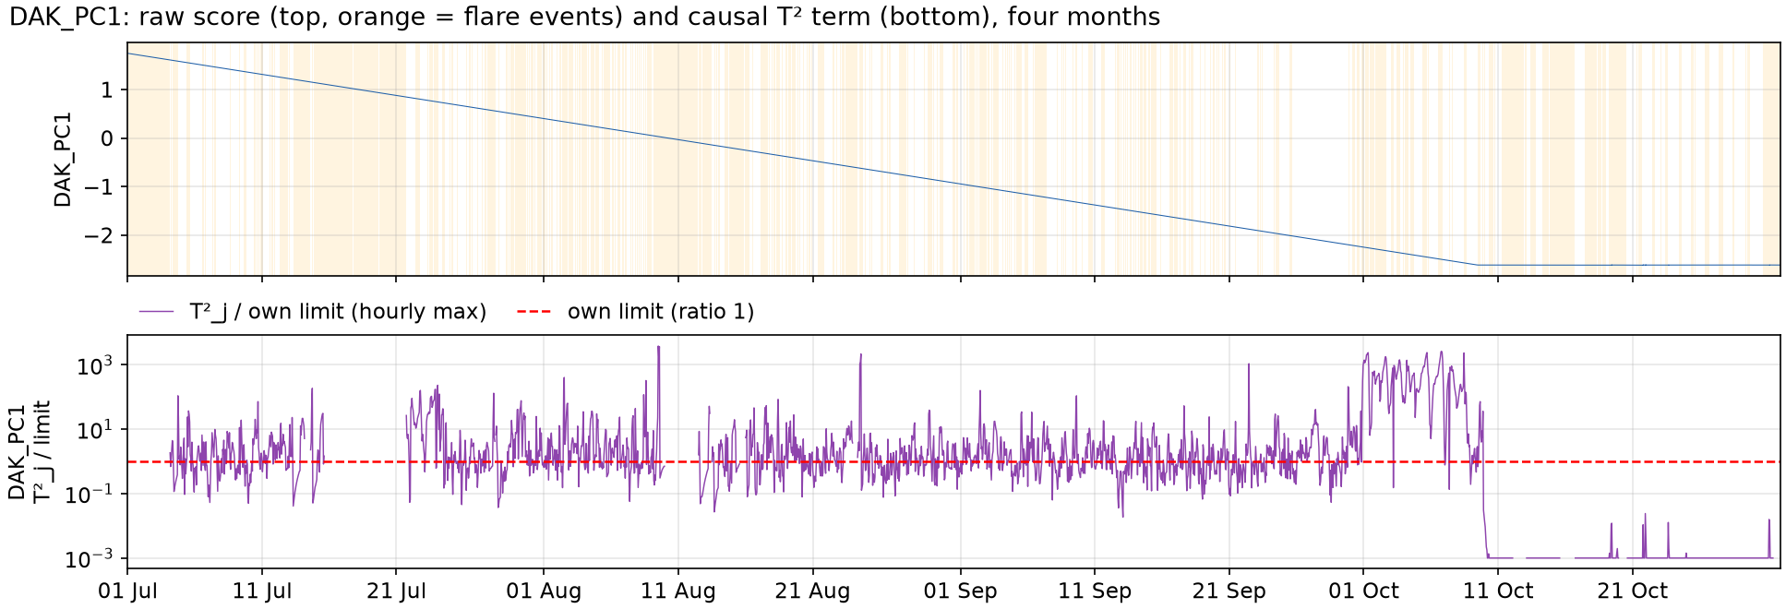
Deep-dive on top TP contributors (1/2): DAK_PC1 is a straight line
Source: outputs/graph/pc_scores.parquet and t2/terms_all_rows.parquet (hourly max). Std-floor share recomputed from the same outputs. Lab run of unit_pca_pc_t2 (commit 2f3c75a), 1-min data, 1 Jul – 31 Oct 2025.
DAK's 3 tags (98PI2002.DACA.PV, 98PIC1102.DACA.PV, 98PIC3307.DACA.PV) have rank 1: one signal, a straight line falling at a constant rate until about 10 Oct, then flat. It does not look like measured process data (UNVERIFIED with the plant).
In a 1,250-min window the line is almost flat: its window std is below 1 % of its overall std in 99 % of window steps, so the code floors it, and its 11 graph parents explain it almost fully.
Small changes then give large T² terms: its ranking says nothing about DAK driving flares.

Slide 18
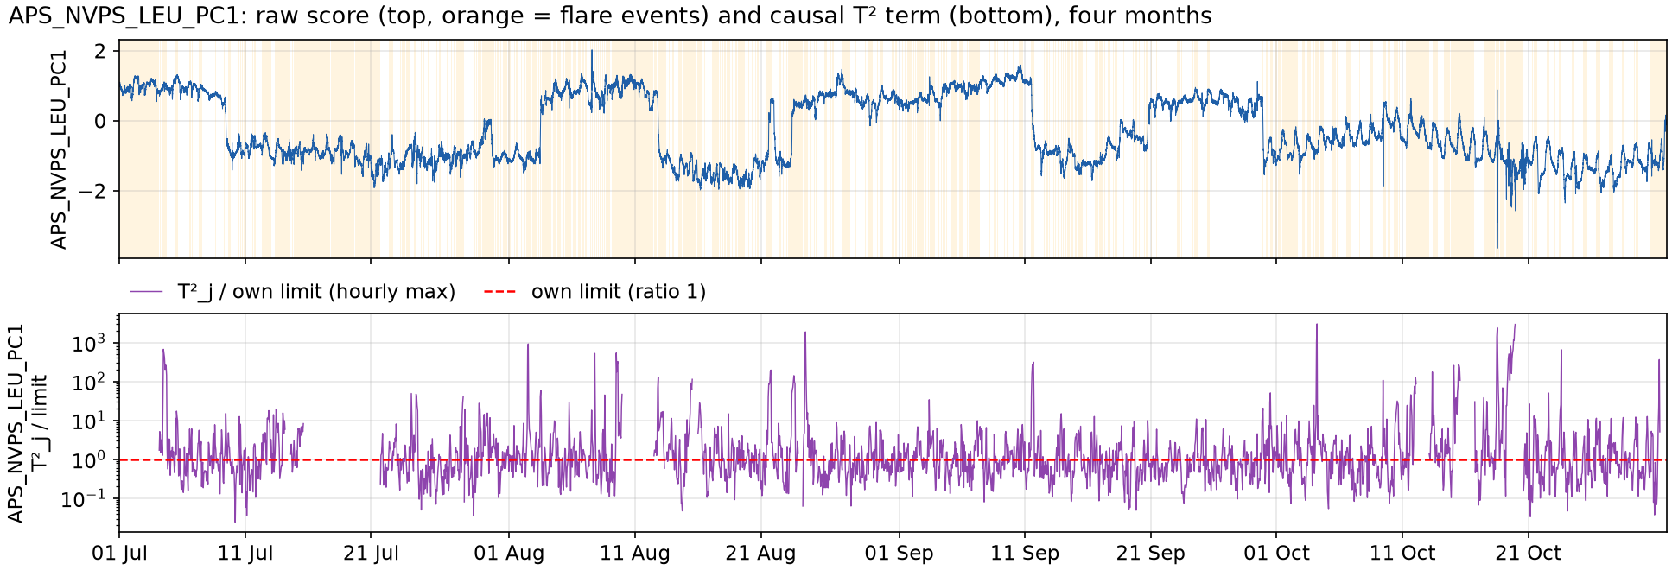
Deep-dive on top TP contributors (2/2): APS_NVPS_LEU_PC1
Source: outputs/graph/pc_scores.parquet and t2/terms_all_rows.parquet (hourly max). Lab run of unit_pca_pc_t2 (commit 2f3c75a), 1-min data, 1 Jul – 31 Oct 2025.
Main tags: THTI402.PV (19 %), 17TI115.PV (19 %), 17TI105.PV (18 %). The score jumps between two levels every few weeks.
Ranked first in 44 TP events and 16 FP gaps; 7 parents in the graph.
Above its limit 11 % of the time before flares vs 8 % in normal time: a real but weak pre-flare signal.

Slide 19
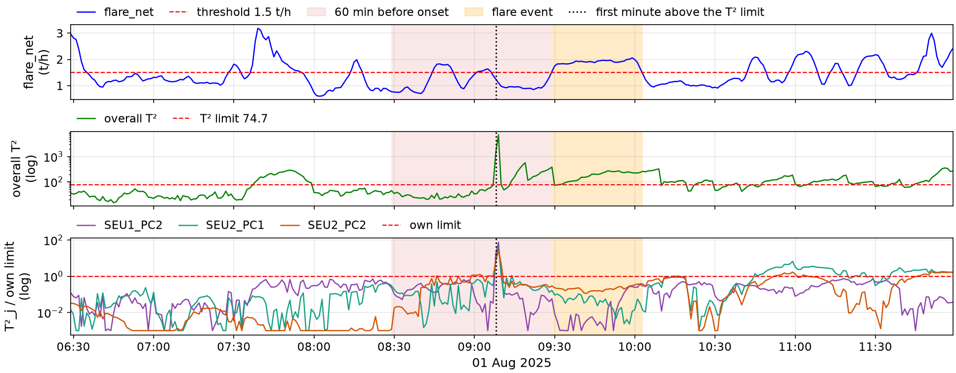
E144: SEU2 spiked 21 minutes before a flare on 1 August
flare_net, overall T² and the T² terms of the top 3 PCs, 3 h before to 2.5 h after onset. Source: outputs/tables/flare_net_raw.parquet, t2/t2_all_rows.parquet, terms_all_rows.parquet, event_outcomes.csv (E144). Lab run of unit_pca_pc_t2 (commit 2f3c75a), 1-min data, 1 Jul – 31 Oct 2025.
Onset 01 Aug 2025 09:29, 34 min, peak 2.06 t/h. T² above its limit for 18 of 60 min of the window, first at 09:08 (21 min before onset).
Top 3 at 09:08: SEU1_PC2 17.2×, SEU2_PC1 8.0×, SEU2_PC2 7.3× their own limits. The warning is a short spike at 09:08; most of the 18 minutes above the limit come after it.

Slide 20
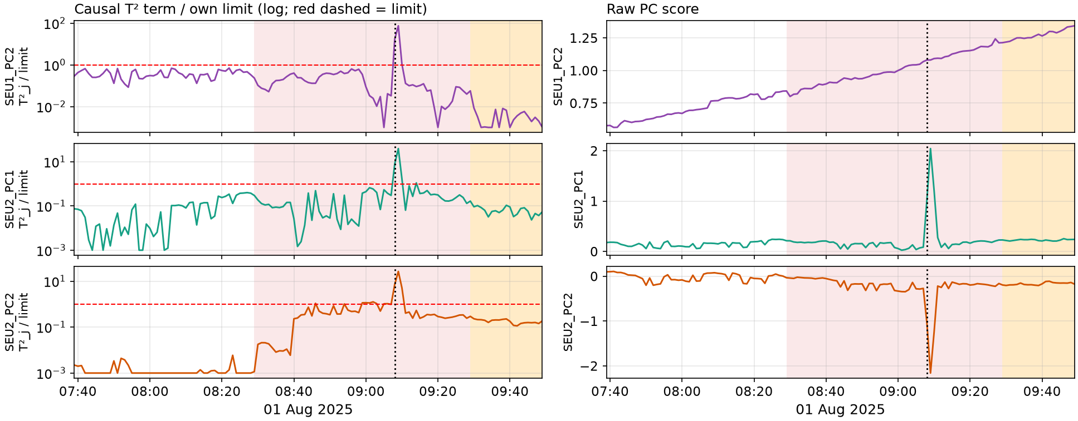
E144 zoom: SEU1_PC2 ranks first because its parent SEU2_PC1 spiked
Zoom: 110 min before to 20 min after onset; each row = one of the top 3 PCs, its T² term (left) and raw score (right). Source: outputs/t2/terms_all_rows.parquet, graph/pc_scores.parquet. Lab run of unit_pca_pc_t2 (commit 2f3c75a), 1-min data, 1 Jul – 31 Oct 2025.
SEU1_PC2: tags 02TI219.PV (29 %), K604BTI1.PV (28 %); 6 graph parents incl. SEU2_PC1.
SEU1_PC2 itself changes smoothly. Its T² term jumps at 09:08 because its parent SEU2_PC1 spikes and the regression expects SEU1_PC2 to follow. The real move is in SEU2_PC1.

Slide 21
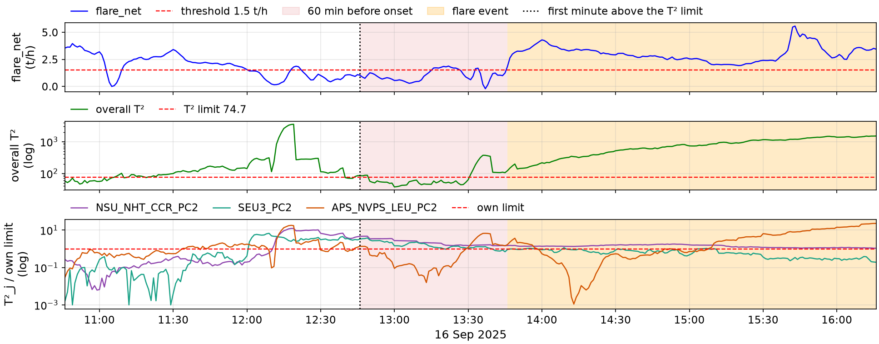
E449: T² was already high an hour before a 5.6 t/h flare on 16 Sep
flare_net, overall T² and the T² terms of the top 3 PCs, 3 h before to 2.5 h after onset. Source: outputs/tables/flare_net_raw.parquet, t2/t2_all_rows.parquet, terms_all_rows.parquet, event_outcomes.csv (E449). Lab run of unit_pca_pc_t2 (commit 2f3c75a), 1-min data, 1 Jul – 31 Oct 2025.
Onset 16 Sep 2025 13:46, 226 min, peak 5.58 t/h. T² above its limit for 19 of 60 min of the window, first at 12:46 (60 min before onset).
Top 3 at 12:46: NSU_NHT_CCR_PC2 4.7×, SEU3_PC2 3.3×, APS_NVPS_LEU_PC2 1.4× their own limits. T² was above the limit when the window opened and again from about 13:30: counted as TP, but the change began before the window (next slide).

Slide 22
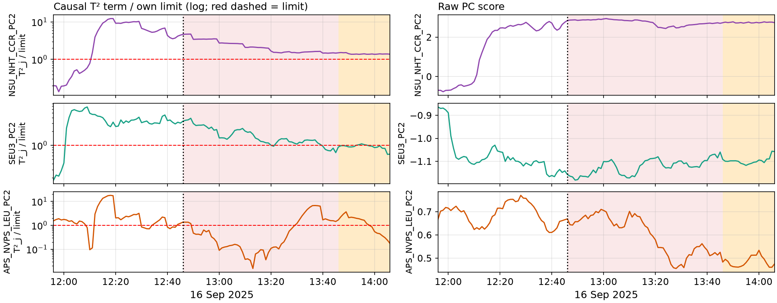
E449 zoom: NSU_NHT_CCR and SEU3 shifted 100 minutes before onset
Zoom: 110 min before to 20 min after onset; each row = one of the top 3 PCs, its T² term (left) and raw score (right). Source: outputs/t2/terms_all_rows.parquet, graph/pc_scores.parquet. Lab run of unit_pca_pc_t2 (commit 2f3c75a), 1-min data, 1 Jul – 31 Oct 2025.
NSU_NHT_CCR_PC2: tags 102TI4651N.DACA.PV (9 %), 102TI4652N.DACA.PV (9 %); 0 graph parents.
NSU_NHT_CCR_PC2 steps up and SEU3_PC2 steps down around 12:05 – 12:10, about 100 min before onset and outside the 60-min window. Both stay at the new level through the flare.

Slide 23
What we have done, and what we will investigate next
Done
Next: proposed investigations
Pipeline on 4 months of 1-min data: 301 tags → 24 PCs → 75-edge graph → causal T².
1. Moving window
explore applying a moving-window approach beyond the T² baseline.
New scoring: 60-min window, one count per flare event or gap; F1 = 0.765.
2. Direct PC / PCMCI+
test how much data PC or PCMCI+ can take directly, without transformations.
Loops found (3 in the previous run) and removed; the current graph has none.
3. Tag-level PC
run the PC algorithm on tags instead of PCs.
Per-event Excel: outputs/RCA_report.xlsx, sheet events (620 rows, 32 columns), and a figure per event.
4. Edge reduction
heuristics or observations to drop PC → flare_net edges that are not needed.
Found: T² above its limit in 38 % of flare-free minutes, so an always-on alarm scores higher (0.815); DAK_PC1 is a straight-line signal.
5. Nominal-only graph
learn the PC graph from normal operation only; flares are outliers.

